Slide 1
Introduction Sheet

Slide 2
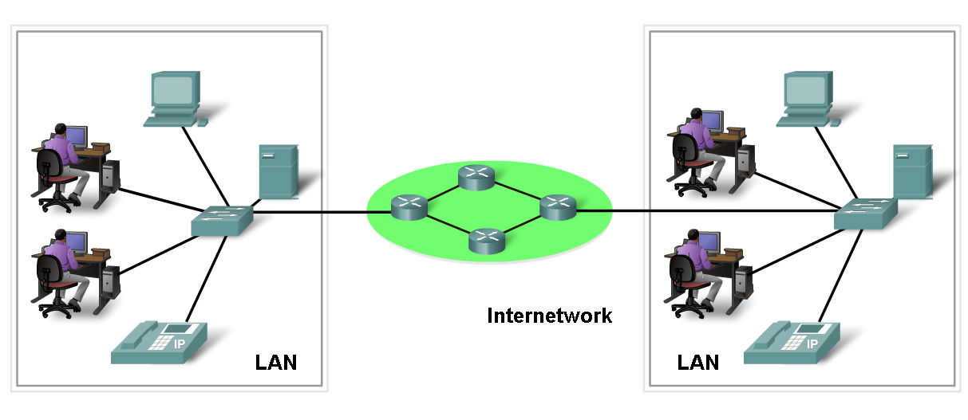
Network definition
Network:
Group of components or devices which are connected together to give the user a certain service (application).

Slide 3
3- Network components
Network has three main components
  End devices (servers and hosts)
  - Source of applications (network aware applications)
  Network Devices
  - Devices that interconnect different computers together
  - ex: Repeaters, hub, bridge, switch, router, NIC and modems
  Connectivity
  - Media that physically connect the computers and network devices
  - ex: Wireless and cables

Slide 4
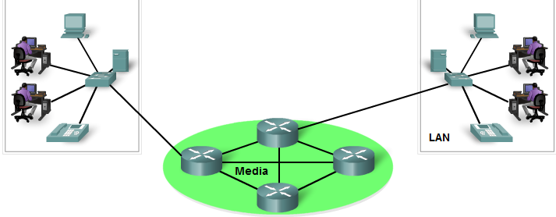
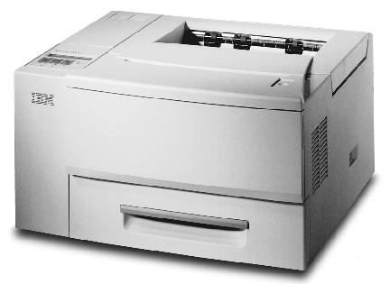
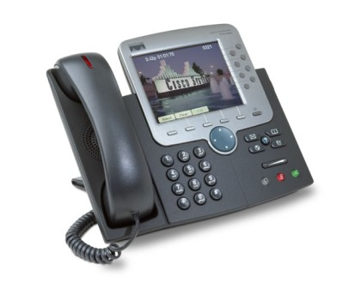
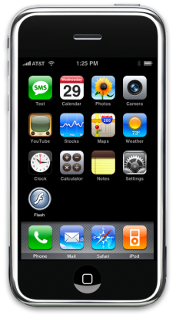
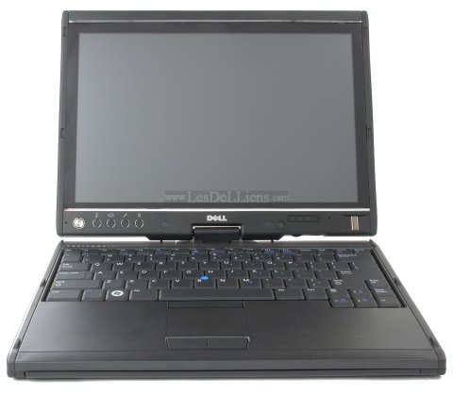

End devices
End devices:
  Computers (work stations, laptops, file servers, web servers)
  Network printers
  VoIP phones
  Security cameras
  Mobile handheld devices (such as wireless barcode scanners, PDAs)
End devices are referred to as hosts.
A host device is either the source or destination of a message.

Slide 5
Intermediary Devices
switch or hub
switch or hub
routers
Intermediary devices:
  Provide connectivity to the network (switches/hubs)
  Connect individual networks (routers)
Examples:
  Network Access Devices (Hubs, switches, and wireless access points)
  Internetworking Devices (routers)
  Security Devices (firewalls)

Slide 6
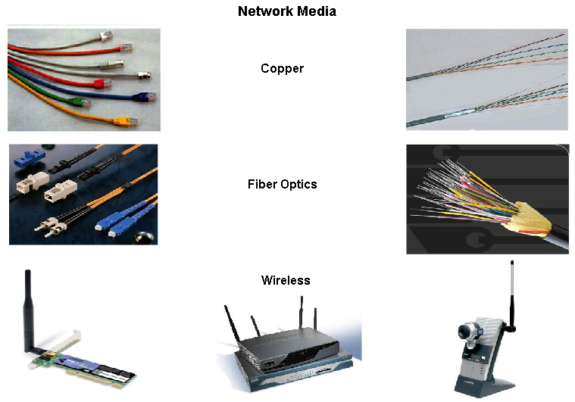
Network Media
Network media: The medium provides the channel over which the message travels from source to destination.
  Metallic wires - encoding into patterns of electrical impulses.
  Fiber optics – encoding into pulses of light (infrared or visible light ranges)
  Wireless – encoding patterns of electromagnetic waves.
(Later: OSI Physical Layer)

Slide 7
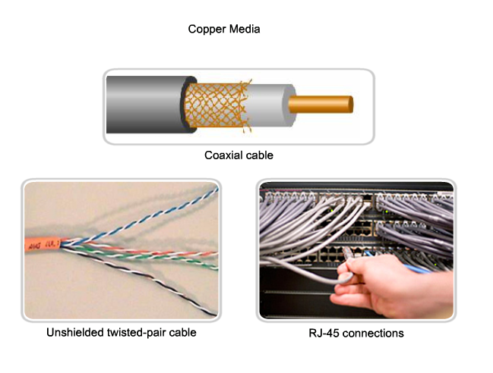
8.3.2 Copper media.

Slide 8
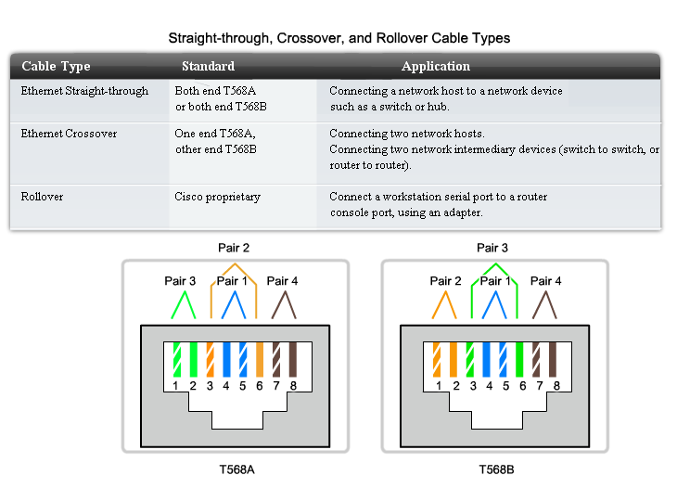
8.3.3 UTP

Slide 9
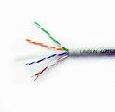
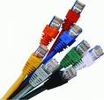


UTP Cable Inside
UTP Cables
UTP Cables Tool Kit
UTP Cables Tool Kit

Slide 10
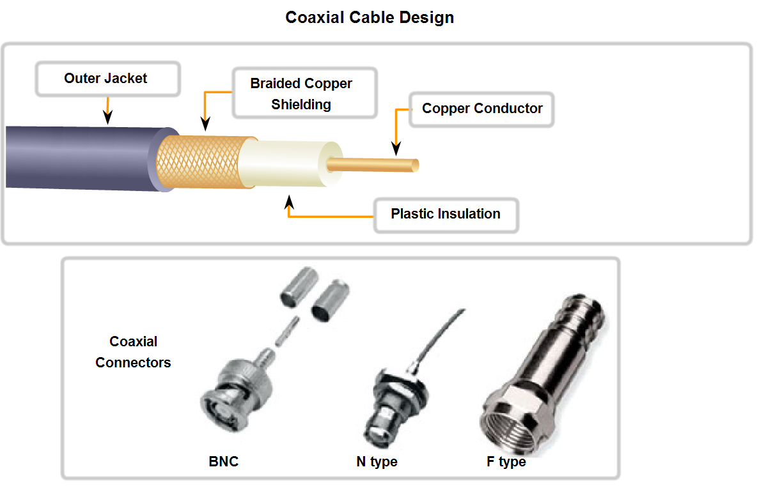
Coaxial Cable
3.1.7

Slide 11


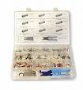

Coaxial Cable Inside
Coaxial Cable
Coaxial Cable Tool Kit
Coaxial Cable Tool Kit

Slide 12
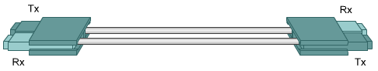
Optical Media
Every fiber-optic cable used for networking consists of two glass fibers encased in separate sheaths.
One fiber carries transmitted data from device A to device B.
The second fiber carries data from device B to device A.
This provides a full-duplex communication link.
3.2.6

Slide 13
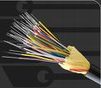
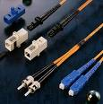
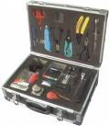

Fiber Optic Inside
Fiber Optic
Fiber Optic Tool Kit
Fiber Optic Tool Kit

Slide 14
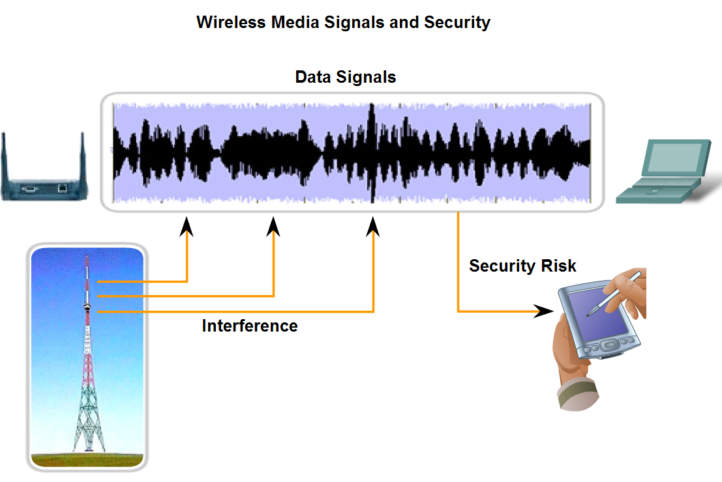
8.3.7 Wireless media.
Describe the role of radio waves when using air as the media and the increased need for security in wireless communications

Slide 15
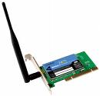
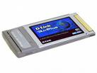
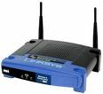
Wireless PC NIC
Wireless Laptop NIC
Wireless Access Point

Slide 16
How is Egypt connected to the internet?

Slide 17
Internet services in Egypt started in October 1993 via a 9.6K link between the Egyptian Universities Network and France
Interconnectivity was drastically improved in 1994 by the provision of a 64K digital access to France in cooperation with IDSC and the EUN and Egypt Telecom. The fiber connectivity was made available on SEMEWE-2
International connectivity to and from Egypt was provided via satellite links using Intelsat and fiber connectivity using SEMWE-2 to Europe and via TAD-12 to the U.S.
IDSC: Information and Decision Support Center

Slide 18
Now three major fiber-optic cables connect Europe to Egypt, the Middle East and Asia.
SMW3 (South East Asia-Middle East-West Europe ), owned by a global consortium of telecom companies. It has been operating since the early days of the internet.
SMW4, also a consortium-owned submarine cable that connects India to Italy by way of the Suez Canal and Alexandria.
FLAG (Fiber-Optic Link Around the Globe) Telecom cable linking Europe and Asia.
The result is a combined national capacity of 17 Gigabytes (GB) per second.
These three lines, combined with the rest of the world's network, add up to over 325,000 miles of submarine telecom cables.

Slide 19
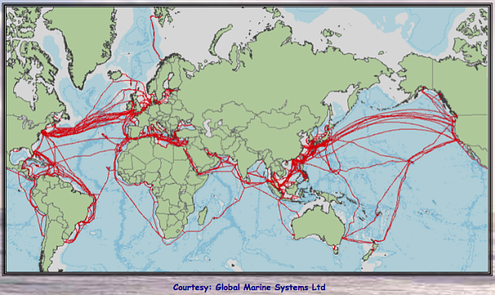

Slide 20
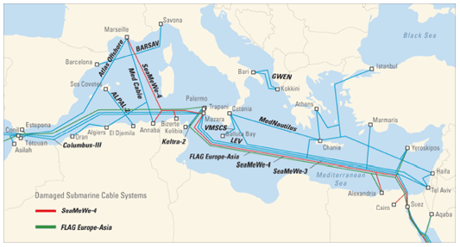
How is Egypt connected to the internet?

Slide 21
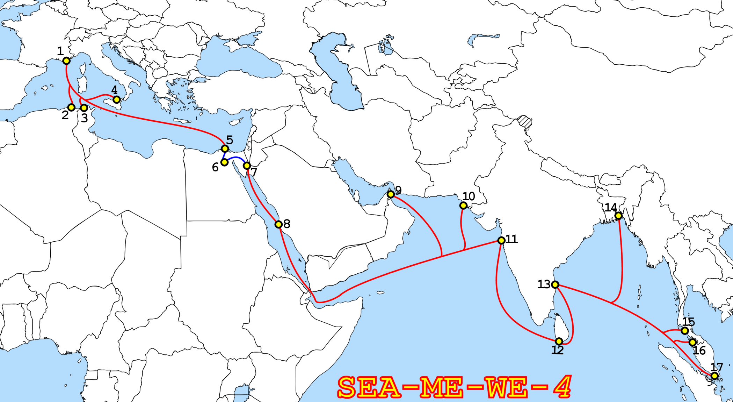
How is Egypt connected to the internet?

Slide 22
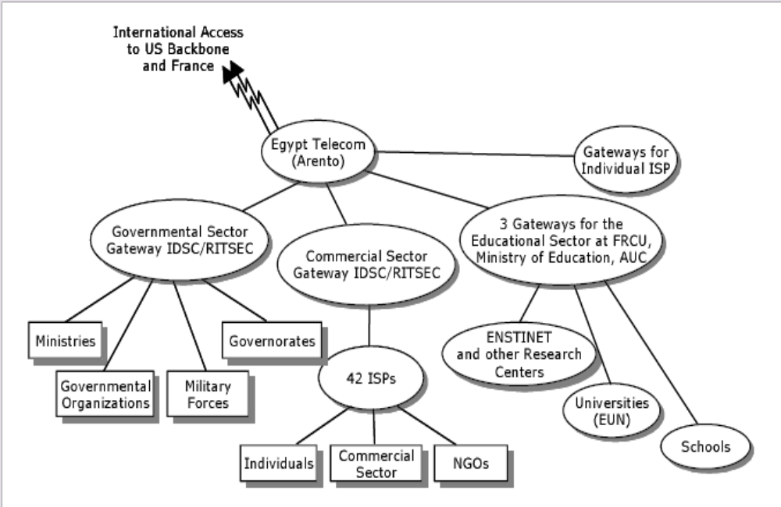

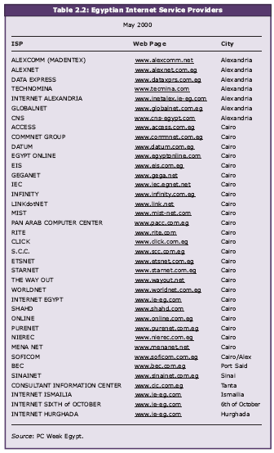
Arento: Arab Republic of Egypt National Telecommunication Organization
RITSEC :The Regional Information Technology and Software Engineering Center
AUC: American university in Cairo
EUN: Egyptian Universities Network
FRCU: Foreign Relations Coordination Unit
NGOs: Non Governmental organizations
ISP: Internet service provider, TEdata, Mena Net, link dot Net Egypt,Nor-net,………
and Europe
Ain
shams
Assiut
Univ
Eng
FCI
Notes:
Arab Republic of Egypt National Telecommunication Organization (ARENTO)
ENSTINET stands for Egyptian National Scientific & Technical Information Network

Slide 23
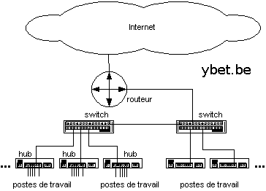
Router

Slide 24
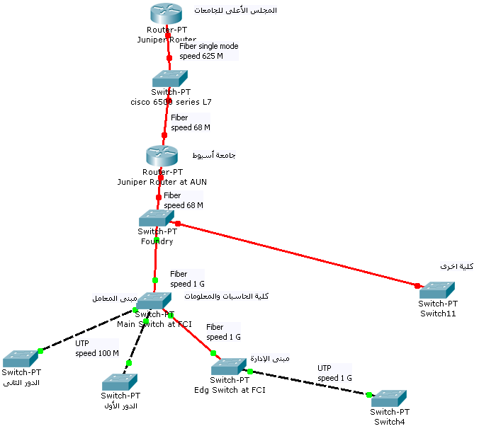
How is Assiut UN. connected to the internet?

Slide 25
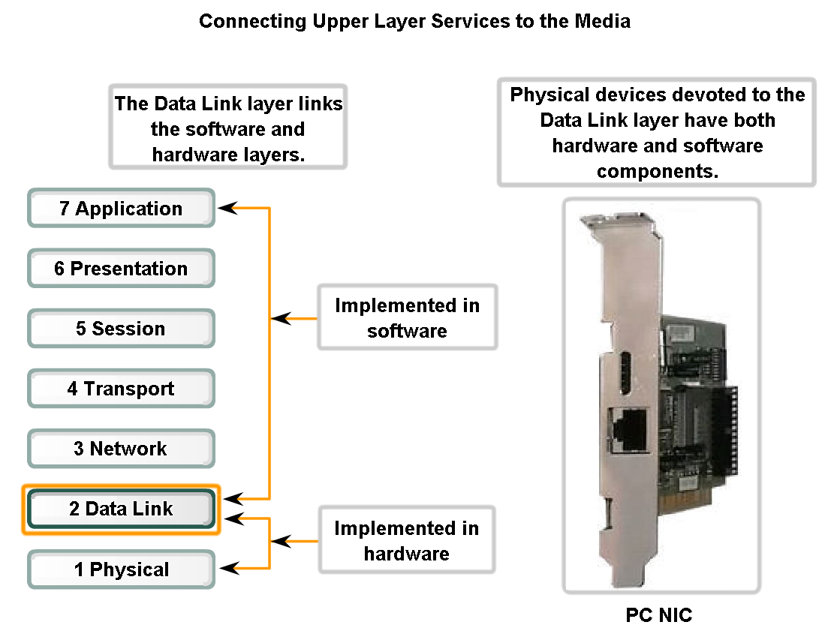
7.1.4 Connecting upper layer services to the media
Describe the role the Data Link layer plays in linking the software and hardware layers

Slide 26
NIC
the Data Link layer is embodied as a physical entity, such as an Ethernet network interface card (NIC), which inserts into the system bus of a computer and makes the connection between running software processes on the computer and physical media.
The NIC is not solely a physical entity, however. Software associated with the NIC enables the NIC to perform its intermediary functions of preparing data for transmission and encoding the data as signals to be sent on the associated media.

